Slide 1
Practice Lab:
This Practice Lab is dependent on Practice Lab 6240, where we detail one method to compile DSE Java client side driver programs. If you do not first complete 6240, then you need instruction towards another means to compile.
This Practice Lab is dependent on Discussion Unit 6244, where most of the objects we create in this lab were introduced.
In this Practice Lab, we create and compile two CQL SELECT loops; the first using Statement(s), and the second using Query Builder
DSE Java Client Side Driver
Notes:
The goal of this Practice Lab is to use two means to deliver a CQL SELECT loop, using the DSE Java client side driver.

Slide 2
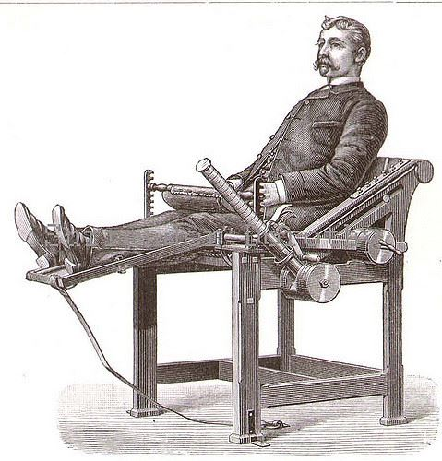
Challenge 1: SimpleStatement
Prerequisites:
Instructions are provided for Linux
We will operate below recommended settings; 1 OS node only, minimum 8 GB RAM, 12 GB RAM preferred
That you have an operating single node DSE Core cluster.
All work done as ‘root’
Notes:
To complete this Practice Lab, the following is assumed:
All prerequisites and conditions as listed above.
All work is expected to be executed on one OS node (instructions are written for Linux).
Because of resource constraints, it is expected you are running a single DSE Core node (no Graph, Spark, Search) on this single OS node.

Slide 3


Challenge 1: Set up (IDE), Make Table and Data
Complete Practice Lab 6240, or another similar lab, where you are able to compile a DSE Java client side program.
Create a CQL keyspace, table, add data.
Use a multi-column partition key and clustering column to your table.

Slide 4
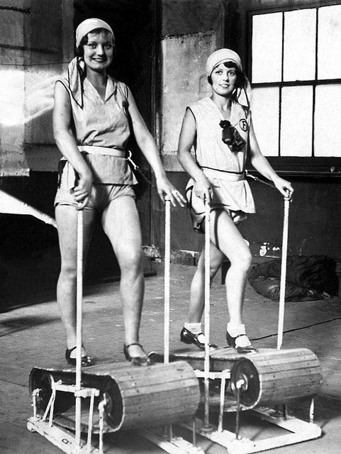
Challenge 1: Simple Statement
Using Discussion Unit 6244-
Deliver a 'fetch loop' using a SimpleStatement
Print rows from the table you created on the previous page.
Notes:
As stated above, complete the following:
Deliver a fetch loop using SimpleStatement.
Print rows from the table you created on the previous page.

Slide 5
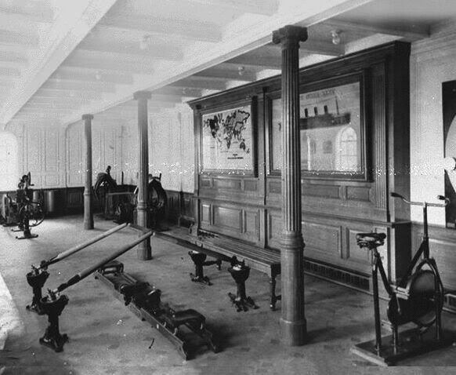
Challenge 2: Query Builder
Using Discussion Unit 6244-
Deliver a 'fetch loop' using Query Builder
Print rows from the table you created on the previous page.
Notes:
As stated above, complete the following:
Deliver a fetch loop using Query Builder.
Print rows from the table you created on the previous page.

Slide 6

Practice Lab:
Lessons Learned
Notes:
Discuss what worked well, poorly, from the Practice Lab.

Slide 7
End of Unit:
Notes:
End of Practice Lab-

